Slide 1

Why and how do place then train Supported Employment interventions work?
9th April 2024
Susan Baxter,
Adam Whitworth,
Jane Cullingworth,
Katherine Runswick-Cole
Mark Clowes.

Slide 2
The problem
One in seven working age adults across countries in the Organisation for Economic Co-Operation and Development identify as having a disability.
Individuals with a disability are about 40% less likely to be in employment than people without disability across the OECD.
A substantial proportion of non-working disabled people state that they wish to work given the right job and right support.

Slide 3
The solution?: Supported Employment place then train models
Conventional models
Train person
e.g. sheltered workshop vocational training
Find work placement
Work placement incorporating training and support -
Individual Placement Support (IPS)
Supported Employment (SE)
Newer models

Slide 4
Place then train models can work
“On all measures the IPS group had significantly better employment outcomes. IPS is highly effective in helping young adults (with severe mental illness) to attain competitive employment”.
“IPS, often with modifications, is a promising employment intervention for several populations in addition to people with serious mental illnesses”.
Bond GR, Drake RE, Campbell K. Effectiveness of individual placement and support supported employment for young adults. Early Intervention in Psychiatry. 2016 Aug;10(4):300-7.
Bond GR, Drake RE, Pogue JA. Expanding Individual Placement and Support to populations with conditions and disorders other than serious mental illness. Psychiat Serv. 2019; 70: 488–98.

Slide 5

How and why might they work
– what are the mechanisms?
Qualitative factors that contribute to the evidenced effectiveness of place-then-train models

Slide 6
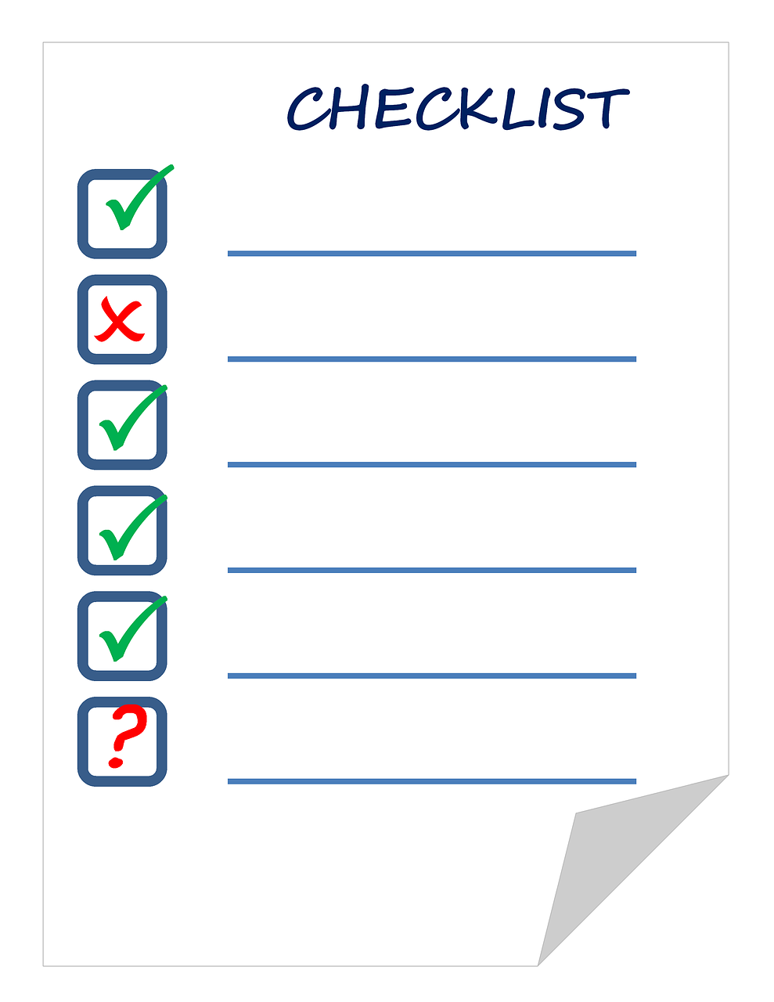
What research evidence is out there?
Systematic review of qualitative or mixed methods studies
Published since 2000
Not people with severe mental illness
High income countries
Supported employment or individual placement support
Provided data
Published in English
MEDLINE, PsycINFO, CINAHL, Social Sciences Citation Index via Web of Science and ProQuest Social Science Collection electronic databases in April 2022
Reference list/other reviews screened/websites/experts/ citation search

Slide 7

Systematic screening
3859 potentially relevant
13

Slide 8
Characteristics of the papers
N=4 UK, n=3 USA(two from the same study), n=2 Sweden (same author), n=2 Norway, n=1 Iceland, n=1 Greece.
Balanced relatively evenly between IPS and SE models.
The earliest study was published in 2005 and the most recent in 2022.

Slide 9


Key themes

Slide 10
Nature of the support
Practical
Individualised
Long-term
Integrated
Person-centred
The advisor
Expertise
Understanding
Broker
Guide
Troubleshooter
Key programme elements
The employment
Normality
Valued
Competence
Stimulating
Well matched

Slide 11
Client-related
Motivation
Expectations
Understanding
Family
Employment and employer-related
Expectations
Employer views
Colleague support
Influencing factors (moderators)
System-related
Understanding of model
Integration
Programme-related
Caseload
Staffing
Leadership

Slide 12
Employment
Attitude to work
Job readiness / employability
Changed outlook
Skills
Confidence
Short-term effects

Slide 13
Wellbeing
Health
Financial security
Independence
Contribution to society
Sense of social belonging
Longer-term effects

Slide 14

6 Key learning points
1. The findings highlight the multiple client, employer, employment, programme, and system-related factors which influence whether an employment outcome is likely to be successful.
.

Slide 15


2. Adherence to a fidelity model is a cornerstone of SE/IPS.
Many factors identified in the review are captured within current fidelity scales however, some key elements are not:
Programme elements
Employment specialist characteristics and roles
Influencing factors
Client-level factors
Programme-level factors - geographical dispersion of clients,
staff turnover, employer, and workplace factors

Slide 16

3. There is a need to continue to challenge and change employer attitudes and expectations around disabled workers.
But also recognise the pressures that employers face and should/could employment support interventions do more to support employers in their employment?

Slide 17

4. The review highlights the importance of values, ways of working and the trusted relationship between advisor and client.
This is in a context of an employment policy landscape dominated by procedural/bureaucratic public employment services, and/or quasi-marketised, profit-led programmes.

Slide 18

5. The review highlights the challenges of integration for any public policy which seeks to connect actors and services from different parts of the health and welfare systems.

Slide 19
6. Considerations of effectiveness tend to emphasise/evaluate the gaining or retaining of employment. The review highlighted wider outcomes to consider:
a changed outlook on life:
job readiness/employability:
a changed attitude towards work:
improved skills, and greater confidence.
Longer-term impacts - wellbeing, health, financial security, social belonging, self-confidence and contributions to society.
Quantitative impact and cost-benefit research should seek to reflect a wider range of relevant outcomes to fully capture the true impacts and fiscal effects of these programmes.

Slide 20
Academic Publication
Baxter S, Cullingworth J, Whitworth A, Runswick-Cole K, Clowes M. Understanding interventions and outcomes in supported employment and individual placement support: A qualitative evidence synthesis. Disability and Health Journal
Available online 12 January 2024, In Press.
https://doi.org/10.1016/j.dhjo.2024.101579

Slide 21
This study/project is funded by the NIHR [Policy Research Programme reference NIHR 202996]. The views and opinions are those of the authors and do not necessarily reflect those of the NIHR or the Department of Health and Social Care.

Slide 22

Up next…
The Supported Employment Quality Framework (BASE): policy landscape, key features,
future possibilities
British Association for Supported Employment (BASE)
29th April 2024, 13:30-14:30. Eventbrite sign-up:
https://www.eventbrite.co.uk/e/supported-employment-beyond-smi-the-supported-employment-quality-framework-tickets-846950340267
2. Client perspectives of Supported Employment beyond SMI
Dr Anne Marie Cullen, Univ Strathclyde
23rd May 2024, 10-11. Eventbrite sign-up:
https://www.eventbrite.co.uk/e/supported-employment-beyond-smi-client-perspectives-tickets-846973058217?aff=oddtdtcreator
3. Insights from RAND Europe: IPS-AD, IPS Grow, and beyond
Joanna Hofman, RAND Europe, 10th June 2014, 12-1. Eventbrite sign-up:
https://www.eventbrite.co.uk/e/supported-employment-beyond-smi-insights-from-rand-europe-tickets-847203607797
Webinar slides and recordings are available on the Resources page of the project website:
www.ipsbeyondsmi.org
Find out about upcoming events via LinkedIn:
#adamwhitworth
#ipsbeyondsmi

