Slide 1
Supported Employment beyond severe mental illness: introducing the policy context, project and webinar series
Prof Adam Whitworth
University of Strathclyde
Adam.Whitworth@strath.ac.uk
X THE PLACE OF USEFUL LEARNING

Slide 3
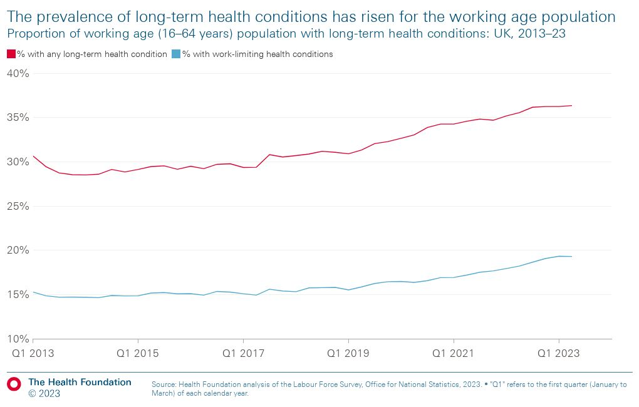
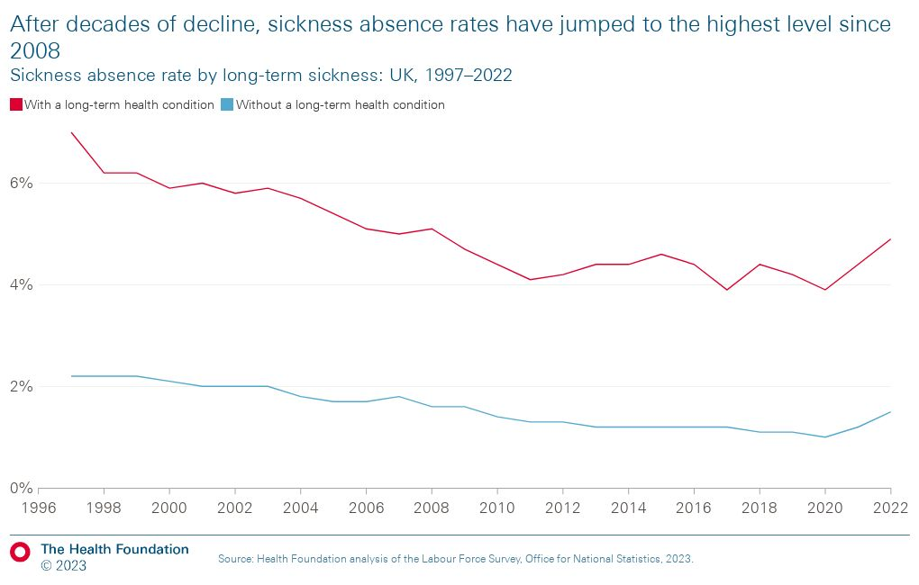
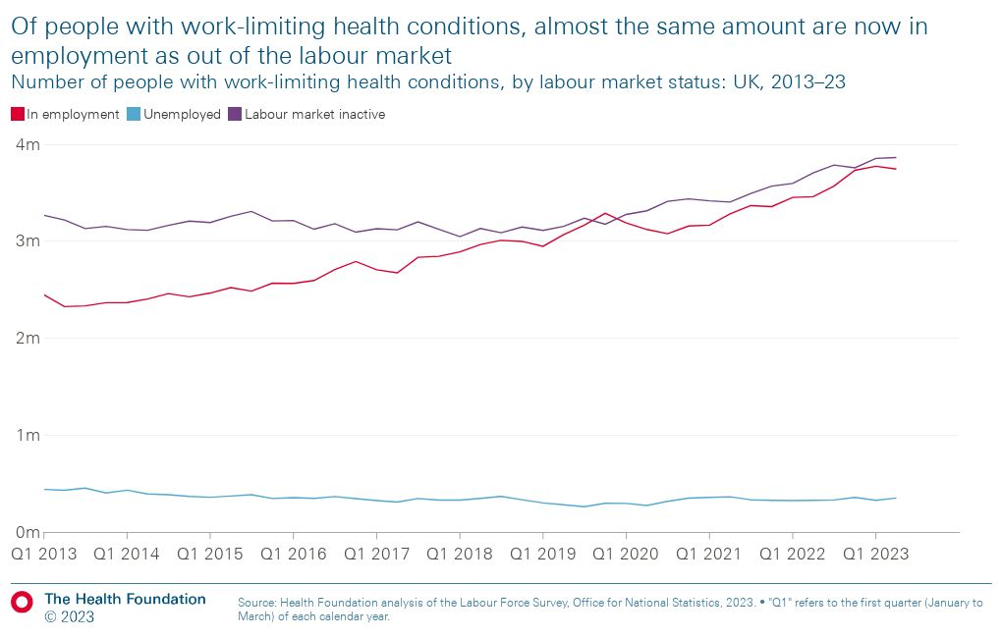
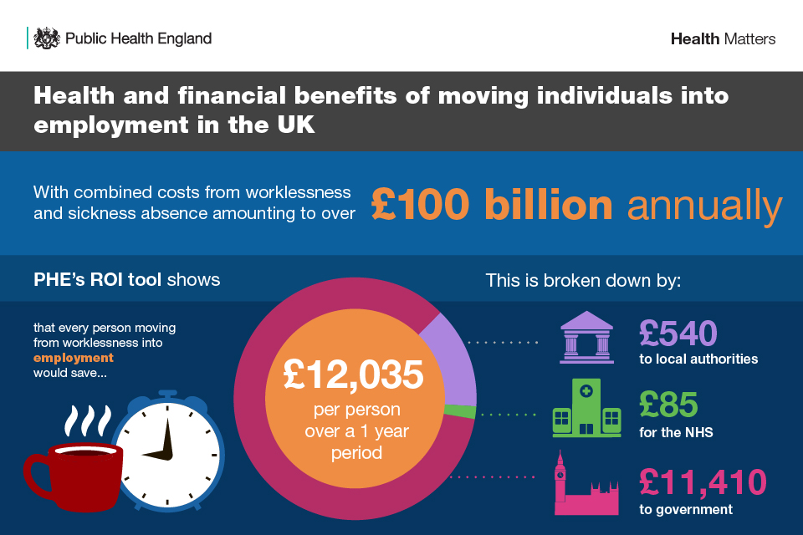
The all too familiar work-health context

Slide 4
Supported Employment: origins & effectiveness
IPS severe mental illness (IPS SMI): Around 30 international RCTs: average effects IPS 55% job starts vs 25% control plus markedly better pace to job start, hours worked (and hence total earnings), job sustainment compared to control

Slide 5
High-level intro to Supported Employment
IPS
SEQF
Fidelity key to Supported Employment: two key & distinct models
Many similarities between SEQF & IPS: values, fidelity, nature of delivery, focus on both process & outcomes
But some important differences too: typical population groups, model implications (components, costs), integration

Slide 6
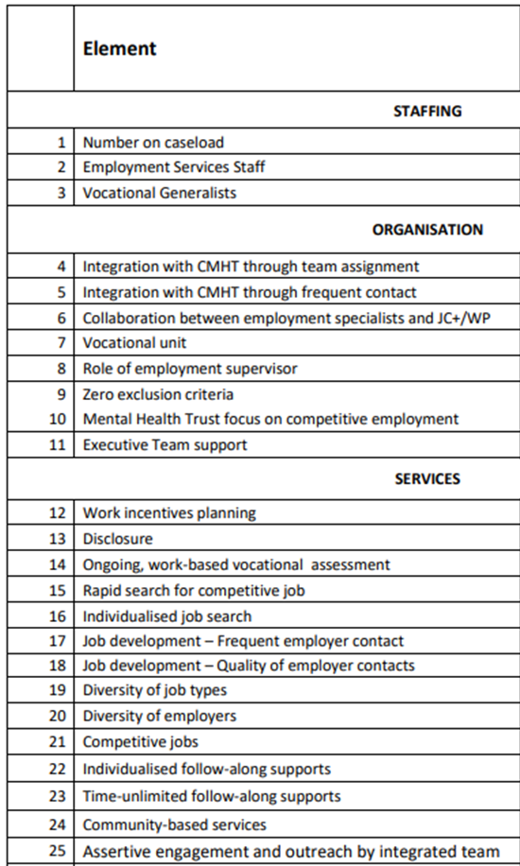
Fidelity
IPS
SEQF
+
Business Results
(job entry, sustainment, pace, jobseeker & employer satisfaction)

Slide 7
Peeking inside a Supported Employment service: so far so generic…
Job matching & securing work
(& Job/Work analysis)
Engagement & Referrals
(Whole Person) Vocational Profiling
Employer Engagement (& Support)
In-work support & Progression

Slide 8
Peeking inside a Supported Employment service: but distinctive under the hood
General & specific proactive employer activities
Employer/dd-side & client/ss-side activities
Tailored in-work support that fades
Some in-work cohorts
Job matching & securing work
(& Job/Work analysis)
Engagement & Referrals
(Whole Person) Vocational Profiling
Employer Engagement (& Support)
In-work support & Progression
Referrals
Disclosure & employer mediation
(with client consent)
IAPT, physios, pain management teams, GPs & PCNs, community hubs, self-referrals, JCP signposting…
IPS: Co-location & Integration
Throughout it is based on fidelity & values

Slide 9
The motivation for our NIHR project: Major Supported Employment innovation & evolution in UK & internationally
NHSE IPS SMI
PHE/OHID IPS-AD
DWP Health-Led Trial
DWP IPS-PC
DWP SEQF Proof of Concept
DWP SEQF Localised Supported Employment
DWP Universal Support

Slide 11
Project overview
National Institute for Health Research (NIHR) funding running Apr 2022 – Mar 2024
Applied academic research with commitment to coproduction, equality & practical impact
Ethical approval from University of Strathclyde
Project advisory group to provide expert advice and guidance, critical scrutiny, and support dissemination and impact

Slide 12
Project objectives
1. To review the international experience and evidence of Supported Employment beyond severe mental illness (WP1);
2. To transform understanding of Supported Employment beyond severe mental illness in design & implementation to support future effectiveness, cost-efficiency, experiences and equity (WP2);
3. To understand the costs and cost-benefits of alternative Supported Employment beyond severe mental illness scenarios and to build new open source cost-benefit tools for wider use (WP3);
4. To maximise applied impacts through webinars and a toolkit of practical resources to support commissioners and providers in future

Slide 13
Project structure
Work Package 1: a systematic review of interventions and evidence of Supported Employment beyond severe mental illness internationally in the past 20 years
Work Package 2: c85 qualitative interviews with providers, co-location partners, service users, commissioners from key interventions. Critical reflections & lessons learned for future
Work Package 3: cost-benefit analysis strand focusing on IPS low-moderate MH &/or MSK and the creation of open source user friendly CBA tools for future public use
Work Package 4: practical resources to help commissioners and providers to effectively design and implement future Supported Employment interventions beyond severe mental illness

Slide 14
Project structure
Work Package 1: a systematic review of interventions and evidence of Supported Employment beyond severe mental illness internationally in the past 20 years
Work Package 2: c85 qualitative interviews with providers, co-location partners, service users, commissioners from key interventions. Critical reflections & lessons learned for future
Work Package 3: cost-benefit analysis strand focusing on IPS low-moderate MH &/or MSK and the creation of open source user friendly CBA tools for future public use
Work Package 4: practical resources to help commissioners and providers to effectively design and implement future Supported Employment interventions beyond severe mental illness

Slide 16
Future webinars through 2024
Project Insights | Policy Insights
Synthesis of international quantitative evidence around vocational outcomes | OHID: IPS-AD
Synthesis of international qualitative evidence around critical success factors and outcome breadth | DWP: The journey to Universal Support
Service user’s experiences & relational welfare | BASE: SEQF & Localised Supported Employment
Employer engagement | Greater Manchester CA & West London Alliance: local perspectives
Fidelity: adaptation, spirit, values, role | IPS Grow
Commissioner perspectives | RAND Europe
Economic evaluation: model scenarios & introducing the open source CBA tool

Slide 17
Up next…
Synthesis of international quantitative evidence around vocational outcomes
Wed 13th March 2024, 14:00-15:30
https://www.eventbrite.co.uk/e/844726247947?aff=oddtdtcreator
Find out about upcoming events via LinkedIn:
#adamwhitworth
#ipsbeyondsmi

Slide 18
NIHR acknowledgement and disclaimer
This study/project is funded by the NIHR Policy Research Programme (PRP) (grant number NIHR202996). The views expressed are those of the author(s) and not necessarily those of the NIHR or the Department of Health and Social Care

Slide 19
Thanks for listening. Questions?
X THE PLACE OF USEFUL LEARNING

